Slide 1
Operators. Type conversions. Arrays. Conditional statement
Ivaniuk Oleh
11.2019

Slide 2
Agenda
JavaScript Operators
- Arithmetic Operators
- Assignment Operators
- Comparison Operators
- Logical (or Relational) Operators
- Bitwise Operators
- Conditional (or ternary) Operators
Type conversions
Arrays
Conditional

Slide 3
JavaScript expressions
An expression is a combination of values, variables, and operators, which computes to a value.
The computation is called an evaluation.
For example, 5 * 10 evaluates to 50: 5 * 10
It is also an expression where a variable is assigned a value: i = 10
Expressions can also contain variable values: n * 5
JavaScript has the following expression categories:
Arithmetic evaluates to a number, for example 22
String evaluates to a character string, e.g. "twotwo"
Logical evaluates to true or false
Object evaluates to an object

Slide 4
Operators

Slide 5
JavaScript operators
An operator is a special character that tells the translator that an operation with some operands is required.
Let us take a simple expression 2 * 3 is equal to 6. Here 2 and 3 are called operands (argument/parameter) and ‘*’ is called the operator.
To work with variables and their values, JavaScript supports all standard operations (operators/actions), most of which are in other programming languages.
Notes:
Оператор — спеціальний знак, який повідомляє транслятору про те, що потрібно виконати операцію з деякими операндами.
У операцій є своя термінологія, яка використовується в усіх мовах програмування

Slide 6
JavaScript operators
Unary is an operation that applies to a single operand. For example, the unary minus operation reverses the sign of a number:
let k = 5;
console.log(-k); // -5, unary minus
console.log(-(k * 2)); // -10, unary minus applied to the result of multiplication k * 2
console.log(-(-3)); // 3
Binary is an operation that applies to two operands. The minus operation also exists in binary form:
let k = 6;
let l = 2;
console.log(k - l); // 4, binary minus

Slide 7
JavaScript operators
JavaScript supports the following types of operators.
- Arithmetic Operators
- Assignment Operators
- Comparison Operators
- Logical (or Relational) Operators
- Bitwise Operators
- Conditional (or ternary) Operators

Slide 8
Arithmetic Operators
Arithmetic (mathematical) operations:
Addition +
let z = 20;
console.log (z + 10); // 30
Subtraction -
let z = 8;
console.log (z - 5); // 3
Multiplication *
let z = 5;
console.log (z * 3); // 15
Division /
let z = 12;
console.log (z / 3); // 4
The remainder of the division (division modulo) %
console.log (8 % 4); // 0
console.log (7 % 3); // 1
console.log (8 % 3); // 2

Slide 9
Arithmetic Operators. Increment
Increment ++ - increases the value of the variable by one. There is a prefix increment that first increments the variable by one, and then returns its value. And there is a postfix increment that first returns the value of the variable, and then increments it by one:
let m = 5;
let n = ++m; // prefix increment (first m increases by 1, then n=m)
console.log(m); // 6
console.log(n); // 6
let k = 5;
let l = k++; // postfix increment (first l=k, then k increases by 1)
console.log(k); // 6
console.log(l); // 5
a = a + 1; // a++
Notes:
Інкремент ++ - збільшує значення змінної на одиницю. Існує префіксний інкремент, який спочатку збільшує змінну на одиницю, а потім повертає її значення. І є постфіксний інкремент, який спочатку повертає значення змінної, а потім збільшує його на одиницю:

Slide 10
Arithmetic Operators. Decrement
Decrement -- decreases the value of the variable by one. There is also a prefix and postfix decrement:
let m = 5;
let n = --m; // prefix decrement (first m decreases by 1, then n=m)
console.log(m); // 4
console.log(n); // 4
let k = 5;
let l = k--; // postfix decrement (first l=k, then k decreases by 1)
console.log(k); // 4
console.log(l); // 5

Slide 11
Exponentiation **
The exponentiation operator ** has recently been added to the language (ES2016).
For a positive integer b, the result of a ** b is a multiplied by itself b times.
For example:
console.log( 2 ** 2 ); // 4 (2 * 2)
console.log( 2 ** 3 ); // 8 (2 * 2 * 2)
console.log( 2 ** 4 ); // 16 (2 * 2 * 2 * 2)
The operator also works for non-integer numbers.
For example:
console.log( 4 ** (1/2) ); // 2 (1/2 degree is equivalent to taking the square root)
console.log( 8 ** (1/3) ); // 2 (degree 1/3 is equivalent to taking a cubic root)

Slide 12
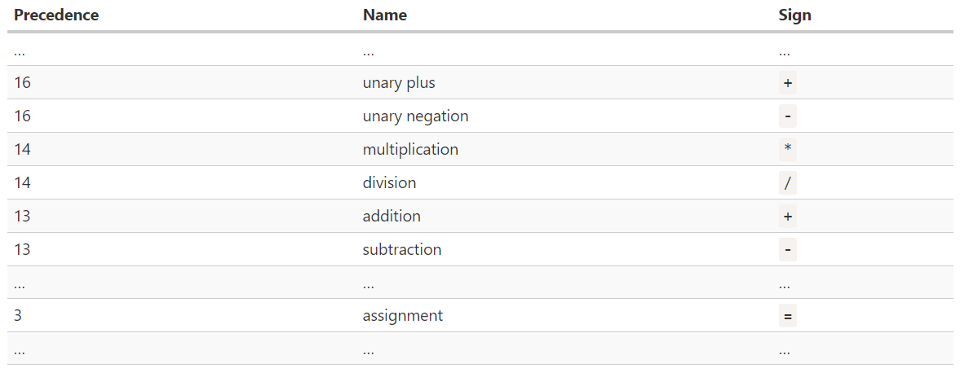
Operator precedence
If an expression has more than one operator, the execution order is defined by their precedence, or, in other words, the default priority order of operators. 2 * 2 + 1
To change the standard course of operations, some expressions can be put (taken) in brackets:
let m = 2;
let n = m * (4 + 2);
console.log(n); // 12
Full
precedence table
Notes:
Оператор пріоритету

Slide 13
String addition
The binary addition operation can be used to combine several lines into one:
let z = "Soft";
let y = "serve";
let res = z + y;
console.log(res); // "Softserve"
If one of the arguments of the binary addition operation is a string, then the second will be converted to a string:
console.log(5 + "1"); // "51"
console.log("5" + 1); // "51"
console.log("10" + true); // "10true"
console.log("10" + null); // "10null"
let z;
console.log("1" + z);
Other mathematical operations work only with numbers and always convert arguments to numbers:
console.log("5" - 2); // 3
console.log(8 / "4"); // 2
// "1undefined"

Slide 14
Assignment Operators
Assignment operation looks like an equal sign =:
let z = 10 - 4;
console.log(z); // 6
It evaluates the expression that is on the right, and assigns the result to the variable that is indicated on the left. The expression can be quite complex and include any other variables:
let z = 1;
let k = 2;
z = z + k + 3; // First, a calculation will be performed using the current value of the variable z, then the result will be saved in it (the old variable z will be erased)
console.log(z); // 6
!
The "=" operator returns a value
Notes:
Він обчислює вираз, який знаходиться праворуч, і присвоює результат в змінну, яка вказується зліва. Вираз може бути досить складним і включати в себе будь-які інші змінні:

Slide 15
Assignment Operators. Modify-in-place
If you need to apply an operation to a variable and save the result in it, you can shorten the record using combined operations:
Addition followed by assignment +=
let z = 5;
z += 2; // z = z + 2;
Subtraction followed by assignment -=
let z = 5;
z -= 2; // z = z - 2;
Multiplication followed by assignment *=
let z = 5;
z *= 2; // z = z * 2;
Division followed by assignment /=
let z = 5;
z /= 2; // z = z / 2;
Receiving the remainder of the division with subsequent assignment %=
let z = 5;
z %= 2; // z = z % 2;
Notes:
Якщо потрібно застосувати операцію до змінної і зберегти результат в неї ж, можна скоротити запис за допомогою суміщених операцій:

Slide 16
Comparison Operators
To check the conditions, comparison operations are used. All comparison operations are binary and return a logical data type (Boolean):
Equals == if the arguments are equal - the result is true, otherwise false
console.log(10 == 10); // true
console.log(10 == 20); // false
Not equal != If the arguments are not equal, the result is true, otherwise false
console.log(10 != 10); // false
console.log(10 != 20); // true
Greater > if the left argument is greater than the right, the result is true, otherwise false
console.log(10 > 10); // false
console.log(10 > 20); // false
Less than < if the right argument is greater than the left - the result is true, otherwise false
console.log(10 < 10); // false
console.log(10 < 20); // true

Slide 17
Comparison Operators
Greater than or equal to >=, if the left argument is greater than the right or the arguments are equal, the result is true, otherwise false
console.log(10 >= 10); // true
console.log(10 >= 20); // false
Less than or equal to <=, if the right argument is greater than the left or the arguments are equal, the result is true, otherwise false
console.log(10 <= 10); // true
console.log(10 <= 20); // true

Slide 18
Comparison Operators. String comparison
If both arguments of the comparison operations are strings, then a string-by-string comparison of strings occurs:
console.log("K" < "L"); // true
Letters are compared alphabetically. The later the letter in the alphabet (the further) the larger it is. First, the first letters are compared, then the second, and so on, until one is larger than the other
If the first letter of the left line is larger, then the left line is larger, regardless of the remaining characters:
console.log("SR" > "RS"); // true
If the first letters in the two lines are the same - the comparison goes further:
console.log("PRT" > "PRS"); // true, because "T" > "S"
Any letter is greater than the absence of a letter:
console.log("PRT" > "PR"); // true, because "T" more than nothing
This comparison is called lexicographic.
Notes:
Якщо обидва аргументи операцій порівняння - рядки, то відбувається побуквенне порівняння рядків:
Букви порівнюються в алфавітному порядку. Чим буква в алфавіті пізніше (далі) тим вона більша. Спочатку порівнюються перші літери, потім другі, і так далі, поки одна не буде більше інший
Будь-яка буква більше відсутності літери

Slide 19
Comparison Operators. Strict equality
A regular equality check == has a problem. It cannot differentiate 0 from false. This happens because operands of different types are converted to numbers by the equality operator == :
console.log(false == 0); // true
console.log("1" == 1); // true
console.log(1 == "01"); // true
console.log(true == 1); // true
If you need to distinguish between similar situations, then use strict equal === or strict not equal !==. They compare without data type conversion, if the argument types are different, then the result will immediately be false:
console.log("1" === 1); // false
console.log(false === 0); // false
console.log("1" !== 1); // true

Slide 20
Comparison Operators. Comparison with null and undefined
Problems with null / undefined are possible when a comparison operation is applied to a variable, and it can have either a numerical value or null / undefined
In a normal comparison (==), null / undefined are equal to themselves and to each other, and nothing more:
console.log(null == null); // true
console.log(undefined == undefined); // true
console.log(null == undefined); // true
console.log(null == 0); // false
console.log(null == "null"); // false
console.log(undefined == 0); // false
console.log(undefined == "undefined"); // false
Это правило прописано в спецификации языка
!
Any comparisons with undefined/null, except strict, should be done with caution.
Notes:
Проблеми з null / undefined можливі, коли до змінної застосовується операція порівняння, а у неї може бути як чисельне значення, так і null / undefined

Slide 21
Logical Operators
To combine several comparison operations, use logical operations:
OR || (logical addition), if at least one of the arguments is true - the result is true, otherwise false
console.log(true || true); // true
console.log(false || true); // true
console.log(true || false); // true
console.log(false || false); // false
And && (logical multiplication), if at least one of the arguments is false - the result is false, otherwise true
console.log(true && true); // true
console.log(false && true); // false
console.log(true && false); // false
console.log(false && false); // false
NOT ! (logical negation, inversion), reverses the value
console.log(!true); // false
console.log(!false); // true

Slide 22
Logical Operators
Examples of combining comparison operations and logical operations:
Whether the value of the variable is in the range from 0 to 100 inclusive :
let x = prompt("Enter your number", "");
let res = x >= 0 && x <= 100;
console.log(res);
Whether the value of the variable is outside the range from 0 to 100:
let x = prompt("Enter your number", "");
let res = x < 0 || x > 100;
console.log(res);

Slide 23
Logical Operators. Short cycle of calculations
Multiple ORs are calculated from left to right. At the same time, in order to save resources, a short cycle of calculations is used.
Suppose you compute several OR in a row: a || b || c || d
If the first argument (a) is true, then the result will certainly be true, and the remaining values are ignored
OR calculates exactly as many values as necessary before the first true, then returns the value that it stopped at, if true is not present at all, the last argument is returned:
console.log(1 || 0 || 2); // 1
console.log(undefined || "Hi" || true); // "Hi"
console.log(0 || "" || false || null || undefined); // undefined
Notes:
АБО обчислює рівно стільки значень, скільки необхідно до першого true, після цього повертає те значення, на якому зупинився, якщо true немає взагалі, повертається останній аргумент

Slide 24
Logical Operators. Short cycle of calculations. Priority
The AND operation also uses a short calculation cycle, only instead of true, AND calculates the values up to the first false:
console.log(1 && 0 && 2); // 0
console.log(0 && 1 && 2); // 0
console.log(1 && -1 && "Data" && true); // true
Operation priority AND more than OR:
console.log(2 || 1 && 0);
First, AND: 1 && 0 will be calculated, and then OR: 2 || 0
// 2
Notes:
Операція && також використовує короткий цикл обчислення, тільки замість істинного, && обчислює значення до першого false

Slide 25
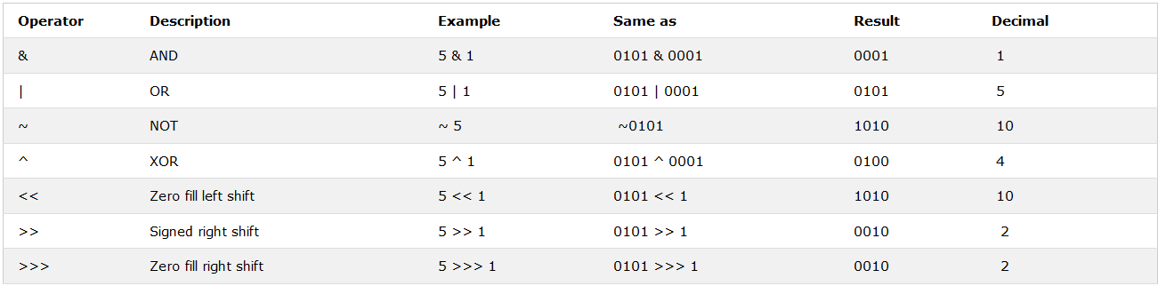
Bitwise Operators
Bit operators work on 32 bits numbers.
Any numeric operand in the operation is converted into a 32 bit number. The result is converted back to a JavaScript number.

Slide 26
Conditional operator (ternary operator)
The conditional operator first evaluates an expression for a true or false value and then executes one of the two given statements depending upon the result of the evaluation.
? : (Conditional )
If Condition is true ? Then value X : Otherwise value Y
Example:
let x = 30;
let y = 50;
result = (x > y) ? 500 : 1000;
console.log(result);
// 1000

Slide 27
Type Conversions

Slide 28
Type Conversions. String
While writing programs, you may need to convert data from one type to another, The three most widely used type conversions are to:
- to String
- to Number
- to Boolean
Convert to string:
Function String()
let a = 20;
let data = String(a);
console.log(data); // "20"
console.log(typeof data); // "string"
Operation + and empty string
let a = 20;
let data = a + "";
console.log(data); // "20"
console.log(typeof data); // "string"

Slide 29
Type Conversions. Number
Convert to Number:
Function Number()
let a = "20";
let num = Number(a);
console.log(num); // 20
console.log(typeof num); // "number"
Unary operation +
let a = "20";
let num = +a;
console.log(num); // 20
console.log(typeof num); // "number"

Slide 30
Type Conversions. Number
Additional useful functions for working with numbers:
Function parseInt() - converts to an integer
console.log(parseInt("7")); // 7
console.log(parseInt("7.5")); // 7
console.log(parseInt("7nm")); // 7
console.log(parseInt("nm")); // NaN
Function parseFloat() - converts to a fractional number
console.log(parseFloat("7")); // 7
console.log(parseFloat("7.125")); // 7.125
console.log(parseFloat("7nm")); // 7
console.log(parseFloat("nm")); // NaN
Function isNaN() - checks if a value represents a number
console.log(isNaN(1)); // false
console.log(isNaN("1")); // false
console.log(isNaN("1m")); // true
console.log(isNaN(true)); // false
console.log(isNaN(null)); // false
console.log(isNaN(undefined)); // true

Slide 31
Type Conversions. Boolean
Boolean conversion:
Function Boolean()
let a = "1";
let bln = Boolean(a);
console.log(bln); // true
console.log(typeof bln); // "boolean"
Double Boolean NOT !!
let a = "1";
let bln = !!a;
console.log(bln); // true
console.log(typeof bln); // "boolean"

Slide 32
Arrays

Slide 33
Arrays. index
There is a special data structure called an array for storing ordered collections. There are 2 ways to create an array:
let arr = [];
let arr = new Array();
In this case, an empty array is created. Also, when created, it can be immediately initialized:
let cities = ["Rome", "Lviv", "Warsaw"];
Elements of the array are numbered starting from zero.
We can get the element by index, indicating its number in square brackets:
console.log(cities[0] ); // Rome
console.log(cities[1] ); // Lviv
console.log(cities[2] ); // Warsaw
If the element is accessed by index greater than the size of the array, then undefined will be returned.

Slide 34
Arrays. Length property
The index also records/changes values for array elements :
let cities = ["Rome", "Lviv", "Warsaw"];
console.log(cities[0]); // Rome
cities[0] = "Berlin";
console.log(cities[0]); // Berlin
You can add elements (expand the array):
let cities = ["Rome", "Lviv", "Warsaw"];
console.log(cities[5]); // undefined – there are only three elements in the array
cities[5] = "London";
console.log(cities[5]); // London
You can find out the current size of the array using the length property:
let cities = ["Rome", "Lviv", "Warsaw"];
console.log(cities.length); // 3

Slide 35
Arrays methods
Arrays provide many methods:
push(... items) - adds items to the end of the array
pop() - removes the element at the end of the array and returns it.
shift() - removes the element at the beginning of the array and returns it.
unshift(... items) - adds items to the beginning of the array.
slice(start, end) – creates a new array, copying elements from start to end (not including end) into it.
splice(pos, deleteCount, ...items) – starting at the pos index, removes deleteCount items and inserts items.
concat(...items) – returns a new array: copies all members of the current array and adds items to it.
forEach(func) – calls func for each element (enumeration)
map() – creates a new array with the results of calling a function for every array element.
…

Slide 36
Conditional Statements

Slide 37
Conditional Statements
Sometimes we need to perform various actions depending on the conditions. You can use conditional statements in your code to do this.
In JavaScript we have the following conditional statements:
- use if to specify a block of code to be executed, if a specified condition is true;
- use if else to specify a block of code to be executed, if the same condition is false;
- use if else if to specify a new condition to test, if the first condition is false;
- use switch to specify many alternative blocks of code to be executed.

Slide 38
if statement
The if statement is the fundamental control statement that allows JavaScript to make decisions and execute statements conditionally.
The syntax for a basic if statement:
if (condition) {
// block of code to be executed if the condition is true
}
The if keyword is followed by a condition in parentheses. A condition is any expression that ultimately returns a boolean type. If the condition is true, then the code from the if block is executed,
Example:
var a = 11;
if (a > 0) {
console.log("Number " + a + " positive");
}

Slide 39
if statement. Boolean conversion
The if (…) statement evaluates the expression in its parentheses and converts the result to a boolean.
Conversion rules:
- A number 0, an empty string "", null, undefined, and NaN all become false.
- Other values become true.
Example:
if (5) {
console.log("Always running");
} else {
console.log("Never done");
}

Slide 40
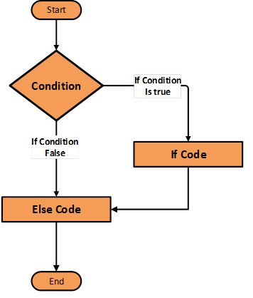
if..else statement
The 'if..else' statement is the next form of control statement that allows JavaScript to execute statements in a more controlled way.
if (condition) {
// block of code to be executed
if the condition is true
} else {
// block of code to be executed
if the condition is false
}
Example:
let a = 11;
if (a > 0) {
console.log("Number " + a + " positive");
} else {
console.log("Number " + a + " negative");
}

Slide 41
if..else..if statement
The 'if..else..if' statement is the next form of control statement that allows JavaScript to execute statements in a more controlled way.
if (condition1) {
// block of code to be executed if the condition1 is true
} else if (condition2) {
// block of code to be executed if the condition2 is true
} else {
// block of code to be executed if no conditions is true
}
Example:
let a = 11;
if (a > 0) {
console.log("Number " + a + " positive");
} else if (a < 0) {
console.log("Number " + a + " negative");
} else {
console.log("Number " + a + " is exactly zero");
}

Slide 42
switch statement
Use the switch statement to select one of many code blocks to be executed.
switch(expression) { case a: // code block break; case b: // code block break; default: // code block }
This is how it works:
- the switch expression is evaluated once.
- the value of the expression is compared with the values of each case.
- if there is a match, the associated block of code is executed.
Notes:
В кінці блоку сase ставиться оператор break, щоб уникнути виконання інших блоків

Slide 43
switch statement. Example
let number = 3 * 3;
switch (number) {
case 8:
console.log( 'Too small' );
break;
case 9:
console.log( 'Exactly!' );
break;
case 10:
console.log( 'Too large' );
break;
default:
console.log( "I don't know such values" );
}
!
If there is no break, then execution will go lower for the following case, while other checks are ignored.

Slide 44
Useful links
https://www.tutorialrepublic.com/javascript-tutorial/
https://www.w3schools.com
http://learn.javascript.ru/array
https://metanit.com/web/javascript/

Slide 45
THANKS

